Slide 2
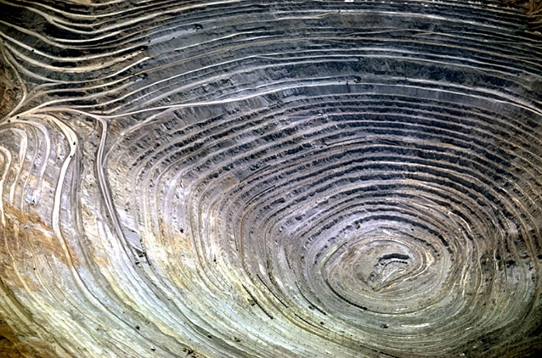
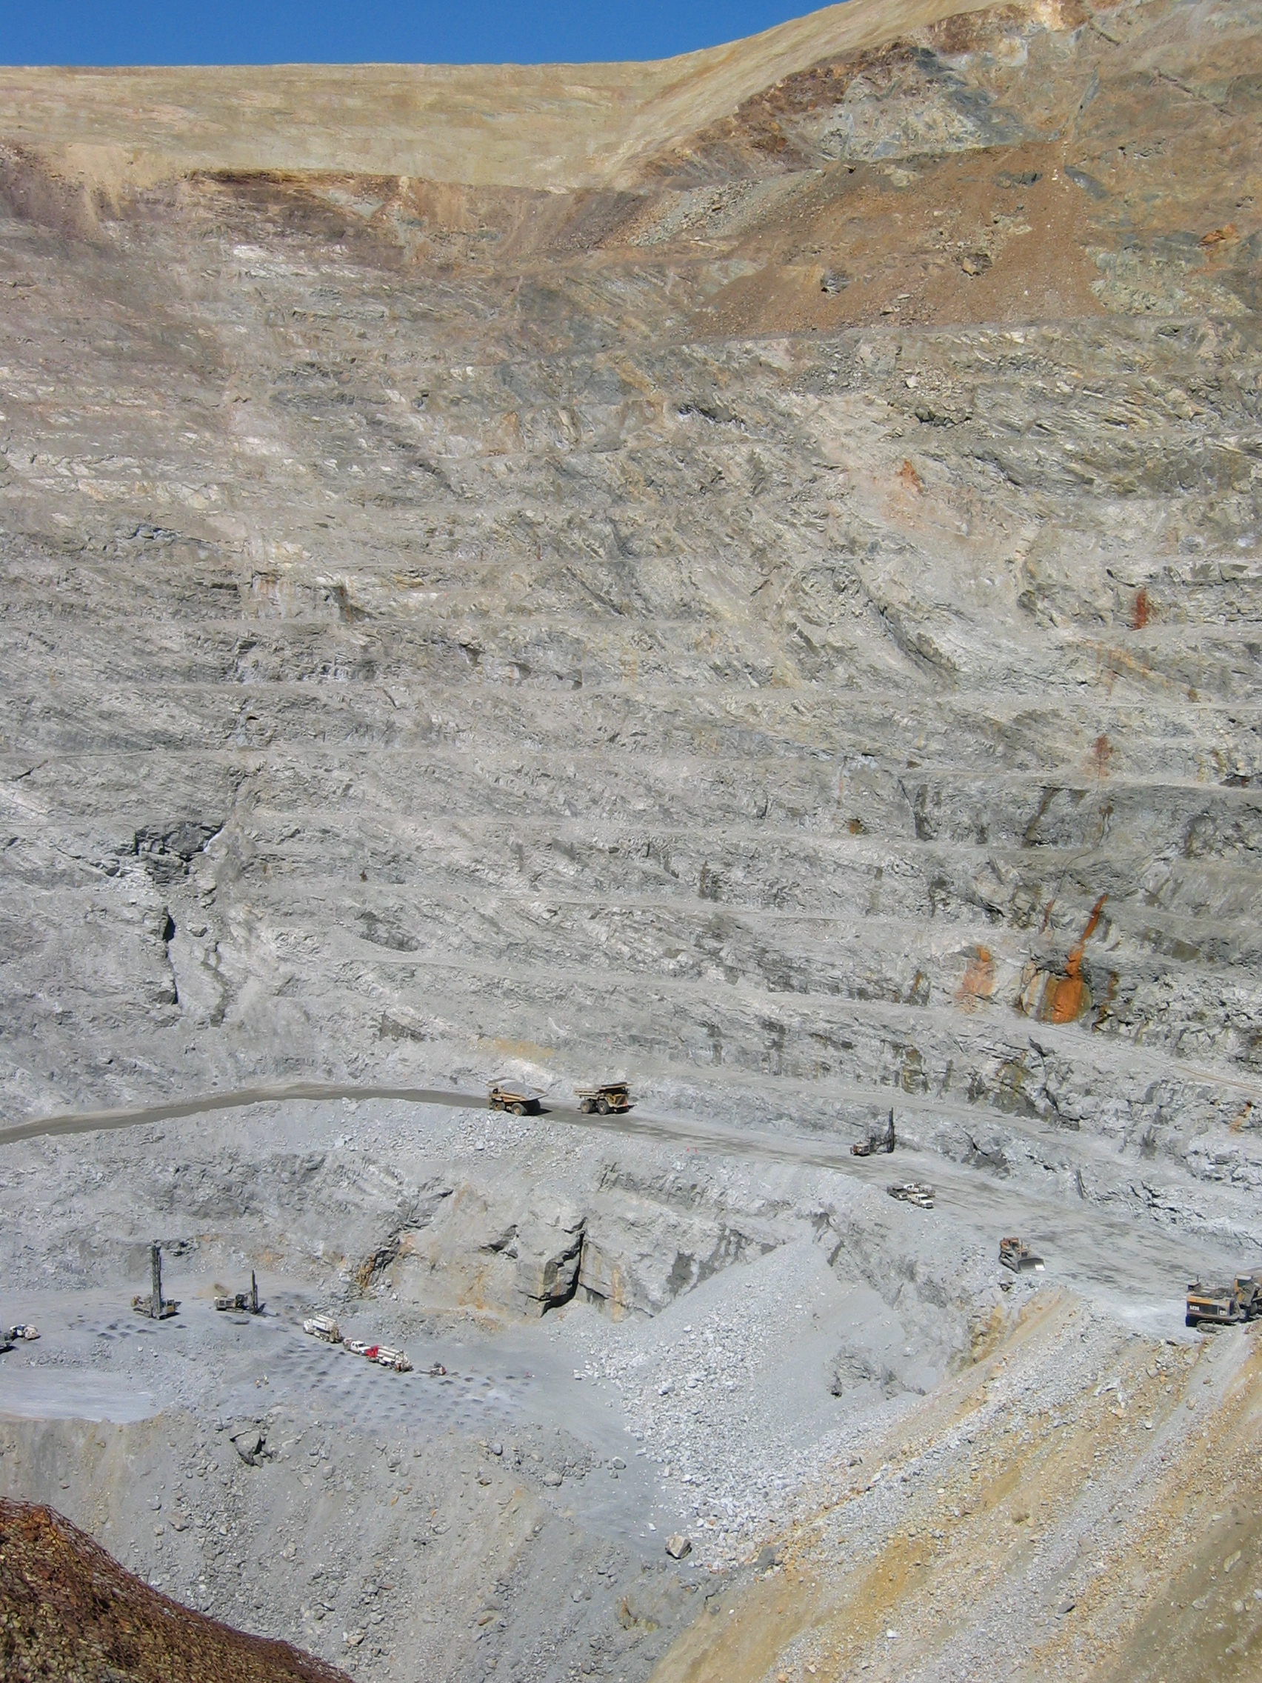
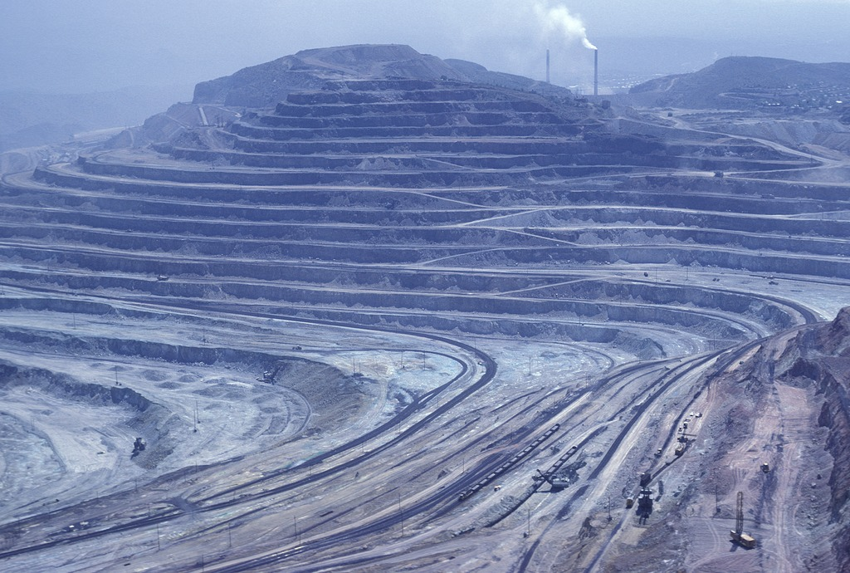
Extraction: Surface Mining
Bingham Copper Mine, Utah.
The largest mines are usually surface mines.
Can produce up to 150,000 tons of ore daily.
Heavy machinery and blasting procedures used.
people
Golden Sunlight Gold Mine, MT. Note people for scale. Floor (where people are standing) was set to be blasted later that day.
Morenci Copper Mine, AZ
Notes:
Image Information Slide 14 Extraction: Surface Mining (I):
Golden Sunlight Mine: Credit: Leah Joseph
Bingham Copper Mine 2, UT: Credit: Louis Maher. “Bingham Copper Mine in the Oquirrh Mtns, southwest of Salt Lake City UT.” Image courtesy of the Earth Science World Image Bank, http://www.earthscienceworld.org/images. Reproduction under certain conditions is allowed for noncommercial use (http://www.earthscienceworld.org/images/imageuse.html).
Morenci Copper Mine, AZ: Credit: Michael Collier. “At Morenci near Clifton, Arizona the countryside is denuded of trees and a large open-cut mine reveals multicolored layers of copper bearing rock.” Image courtesy of the Earth Science World Image Bank, http://www.earthscienceworld.org/images. Reproduction under certain conditions is allowed for noncommercial use,http://www.earthscienceworld.org/images/imageuse.html).

Slide 3
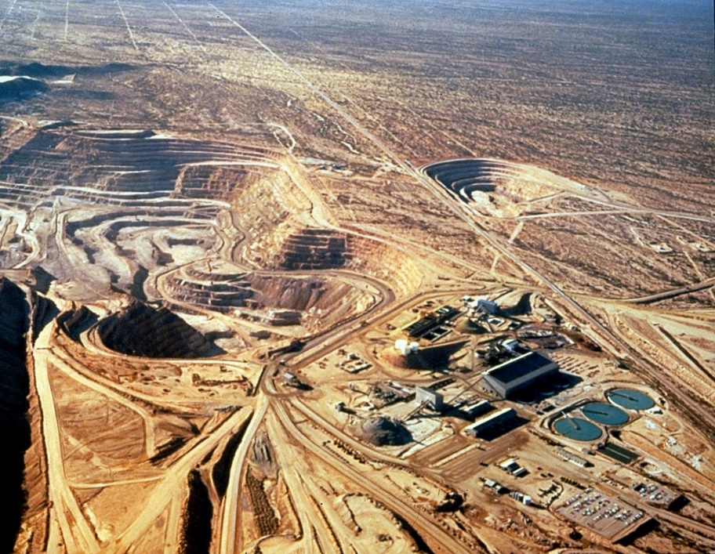
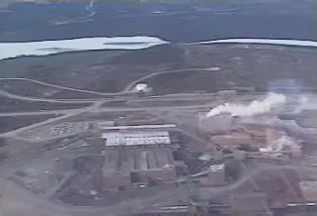
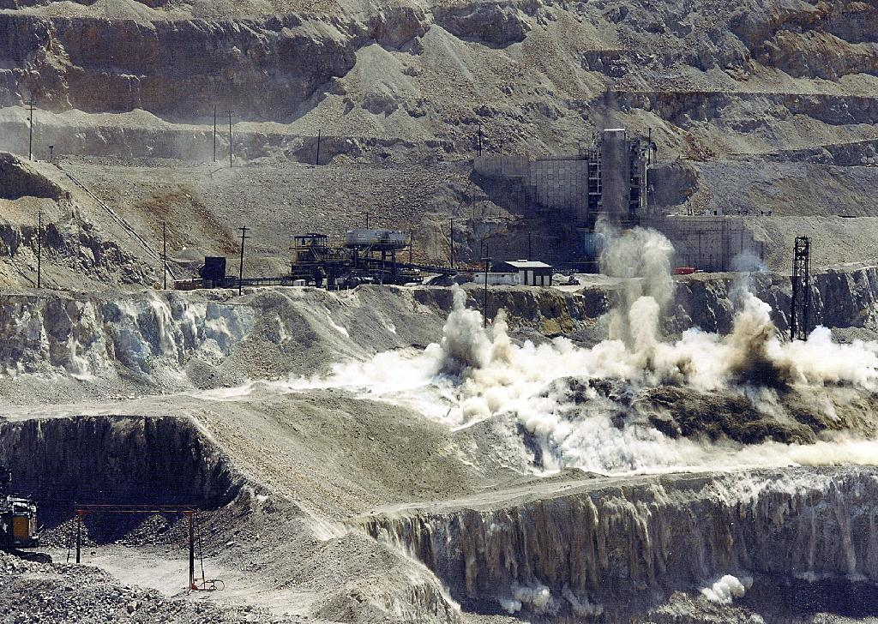
Extraction: Surface Mining
Often causes significant land disturbance.
Creation of much waste material.
~2–3 tons of waste rock/ton ore
Check out this video on blasting (~5 minutes):
Three different copper/molybdenum surface mines, AZ.
“The World’s Largest Recorded Mining Blast” from the Iron Ore Company of Canada.
Blasting.
Notes:
Image Information Slide 15 Extraction: Surface Mining (II):
Three Adjacent Mines: Credit: ASARCO. “Aerial photo of 3 adjacent copper/molybdenum open pit mines in Arizona.” Image courtesy of the Earth Science World Image Bank http://www.earthscienceworld.org/images. Reproduction under certain conditions is allowed for noncommercial use, (http://www.earthscienceworld.org/images/imageuse.html).
Blasting at Mine: Credit: Travis Hudson, American Geological Institute. “Blasting to break ore into fragments that can then be loaded into very large trucks.” Image courtesy of the Earth Science World Image Bank, http://www.earthscienceworld.org/images. Reproduction under certain conditions is allowed for noncommercial use (http://www.earthscienceworld.org/images/imageuse.html).
Embedded video “The World’s Largest Recorded Mining Blast.” Produced by Jim Cole Productions for The Iron Ore Company of Canada & ICI Explosives Canada downloaded from: http://www.miningaustralia.com.au/news/the-world-s-largest-recorded-mining-blast-video- and embedded with permission on 6/19/14 from Cole Latimer, Managing Editor, Australia Mining, Cirrus Media Pty Limited, Australia.

Slide 4
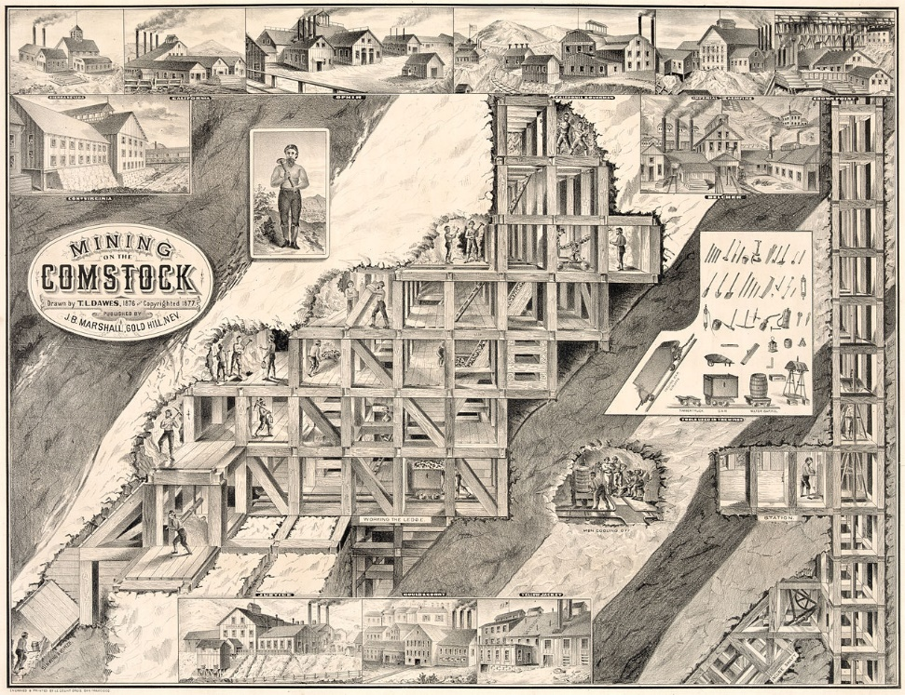
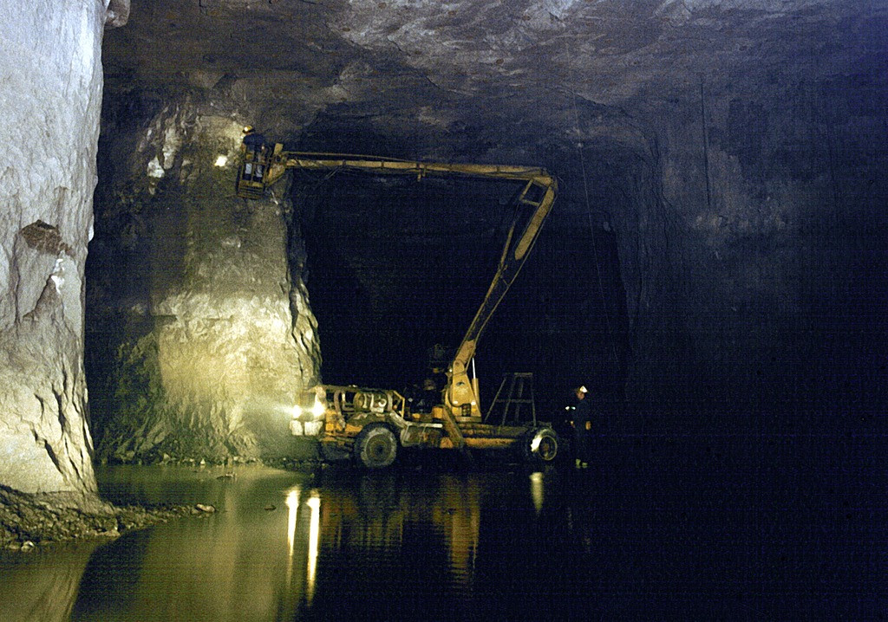
Extraction: Underground Mining
Includes use of tunnels and/or vertical shafts under the ground or into a mountain.
Usually smaller operations (i.e., a few 100,000 to 1 x 10⁶ tons over the lifetime of a mine).
Less land disturbance.
Less waste rock.
Waste rock can be moved to the surface or used to fill in mine areas no longer in use.
Large equipment in an underground mine.
Notes:
This old lithograph of the mining of the Comstock silver deposit in the western Utah Territory (now Nevada) from 1877 gives a sense of the complex tunneling within underground mines.
Image Information Slide 16 Extraction: Underground Mining:
Large Equipment Underground Mine: Credit: Travis Hudson, American Geological Institute. “Large equipment used in underground mining operations.” Image courtesy of the Earth Science World Image Bank, http://www.earthscienceworld.org/images. Reproduction under certain conditions is allowed for noncommercial use, http://www.earthscienceworld.org/images/imageuse.html.
Comstock Deposit: Image of Lithograph from U.S. Library of Congress: Credit for drawing: T.L. Dawes (1877) Downloaded http://upload.wikimedia.org/wikipedia/commons/thumb/1/1c/Mining_on_the_Comstock.jpg/1280px-Mining_on_the_Comstock.jpg as a public domain file as it was published in 1877(http://commons.wikimedia.org/wiki/File:Mining_on_the_Comstock.jpg).

Slide 5
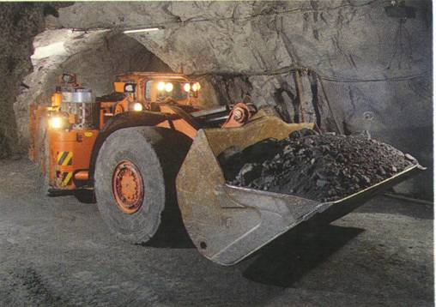
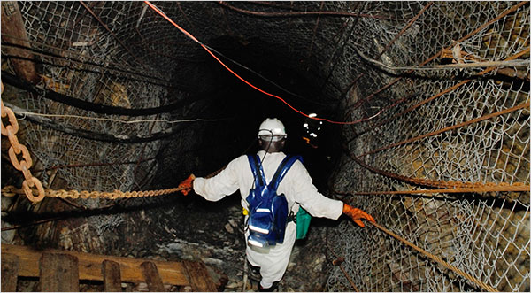
Underground Mining
Used to extract a solid mineral resource that is too deep to allow for economic surface extraction
Potential Issues
Ventilation is big concern here – many smaller shafts needed for ventilation
Flooding can be a problem
Temperature – gets hotter with depth
Mine collapse

Slide 6
Underground Mining Methods
Room and Pillar
Long wall mining
Method used to mine depends upon type of deposit – shape, size, grade
Drilling and Blasting is used in most mines - then removal with automatic diggers onto rail cars or elevators to the surface
Coal mines often use continuous mining machines

Slide 7
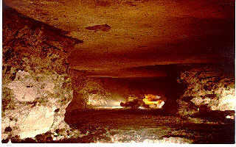
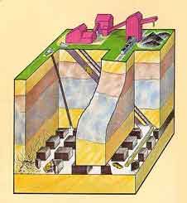
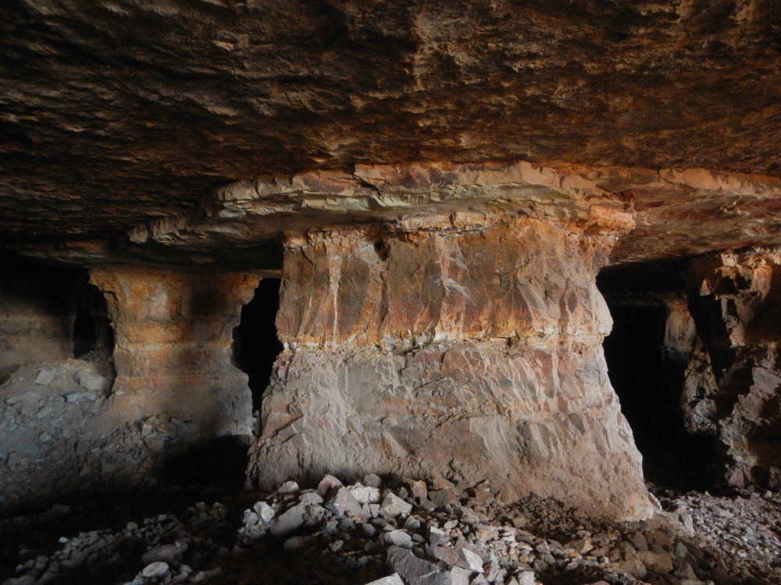
Room and Pillar Method
Implication: you leave some of the ore to hold up the cavern

Slide 8
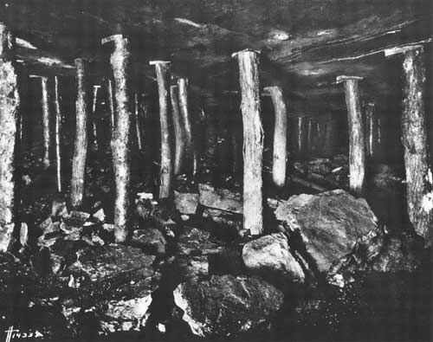
Robbing the Pillars
This was done in coal mines when the
high grade coal was exhausted

Slide 9
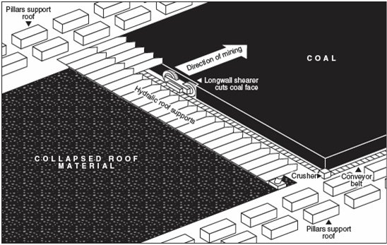
Long Wall Mining: What you mine you let collapse

Slide 10
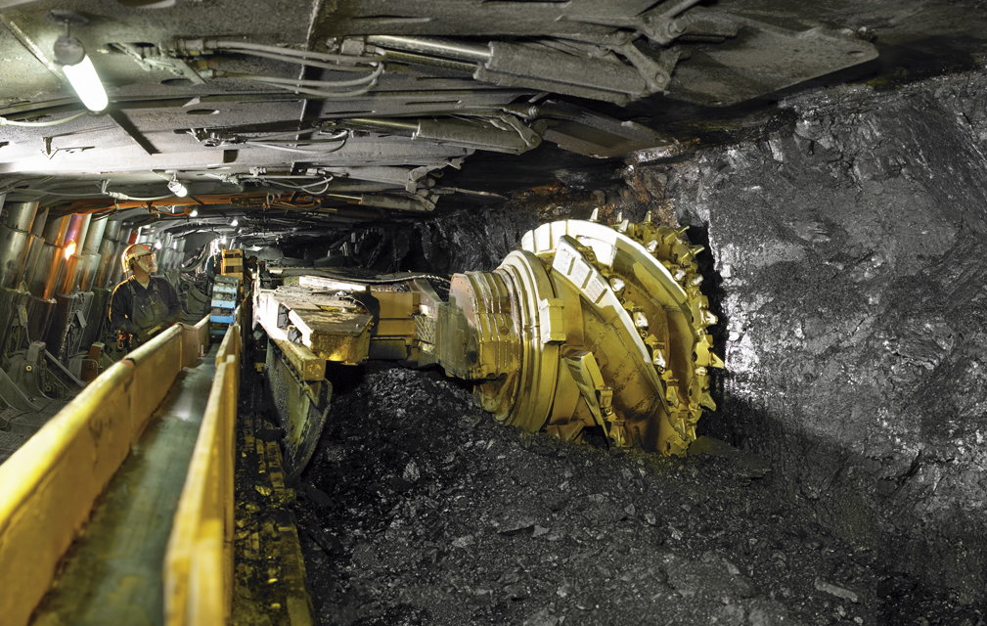
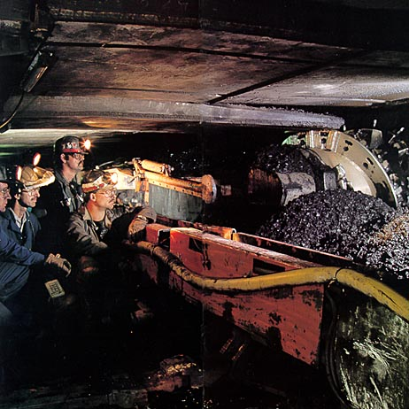
Long Wall Mining: What you mine you let collapse
In the photo on the right note the hydraulic roof supports above and behind the miner

Slide 11
Strength of the rocks and Mining
The strength of the rocks being mined is a large determinant in the mining method and type of mining cavern produced
Sedimentary rocks are usually not as strong – roof collapse is a big concern

Slide 12
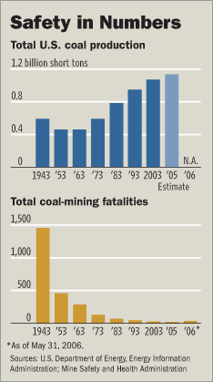
Underground Mining Dangers
Rock falls – collapsing roofs
Poisonous and combustible gases – no use of gasoline in mines
Methane generation – coal mines

Slide 13
Other mining methods

Slide 14
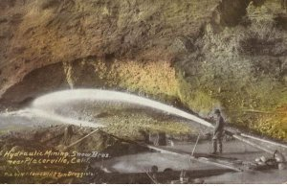
Hydraulic Mining
Used to wash down sediments so that the mud could be sluiced for gold

Slide 15
Very Destructive Practice
Hydraulic Mining
Devastated riparian habitats – killed fish
Destroyed many salmon fisheries
Many rivers will simply not be the same for 100s and 1000s of years
Put tremendous amounts of silt into rivers, clogging bays that they flowed into (such as San Francisco Bay during CA gold rush)

Slide 16
Solution Mining
Injection of fluids into subsurface to dissolve minerals
Types
removal of entire rock with just water – e.g. salt mining
In-situ leaching – e.g. uranium mining

Slide 17
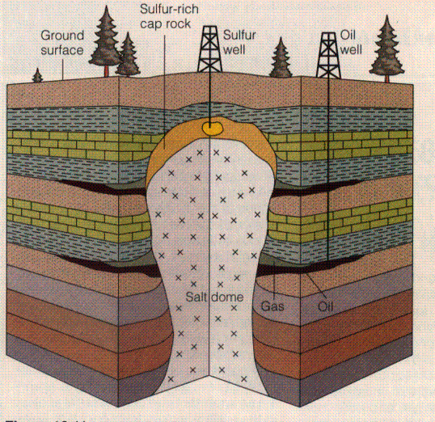
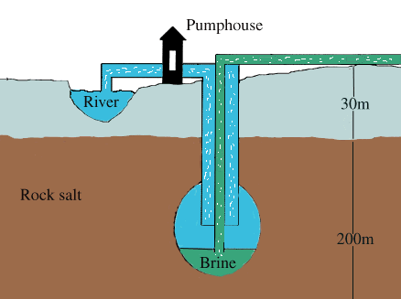
Solution Mining for Salt

Slide 18
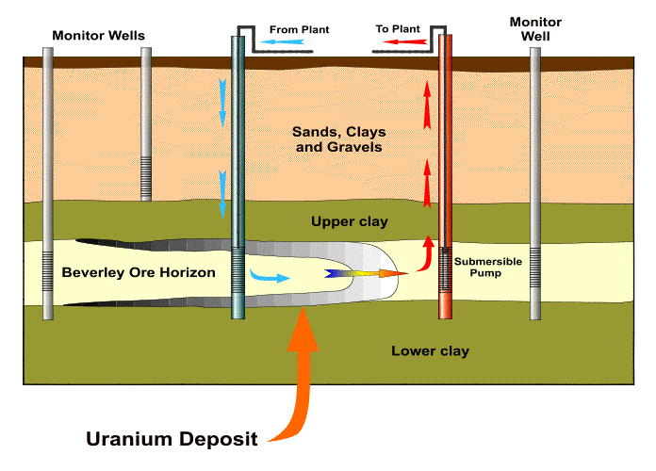
In-situ leaching (ISL)
Uranium
Dissolve soluble minerals from low grade ores with acid solutions (uranium, gold, copper)
Economic extraction of gold ores with a minimum grade of 0.02 ounces/metric tons, as opposed to 0.2 oz/ton for open pit mines
No surface disruption

Slide 19
Exploration
Mining is very expensive.
Taking time and resources to explore is thus important.
Need to determine the location, size, depth, and the orientation/trend of the deposit.
Surface expression (outcrop) of ore
Land surface
Even if you know where it occurs at the surface, can you tell from this outcrop how extensive a deposit this ore might be? Which direction might it go as it gets deeper?
Notes:
Image Information Slide 7: Sketch by Leah Joseph.

Slide 20
Exploration
Mining is very expensive.
Taking time and resources to explore is thus important.
Need to determine the location, size, depth, and the orientation/trend of the deposit.
Surface expression (outcrop) of ore
Land surface
Continuation of ore body below the ground
It could go this way . . .
Notes:
Image Information Slide 8: Sketch by Leah Joseph.

Slide 21
Exploration
Mining is very expensive.
Taking time and resources to explore is thus important.
Need to determine the location, size, depth, and the orientation/trend of the deposit.
Surface expression (outcrop) of ore
Land surface
Continuation of ore body below the ground
Or maybe it goes this way . . .
Notes:
Image Information Slide 9: Sketch by Leah Joseph.

Slide 22
Exploration
Mining is very expensive.
Taking time and resources to explore is thus important.
Need to determine the location, size, depth, and the orientation/trend of the deposit.
Surface expression (outcrop) of ore
Land surface
Continuation of ore body below the ground
Or maybe it goes this way. If you can get this information, it will help you decide where to mine, what direction to mine in, what technique is necessary, and the extent of the ore body!
Notes:
Image Information Slide 10: Sketch by Leah Joseph.

Slide 23
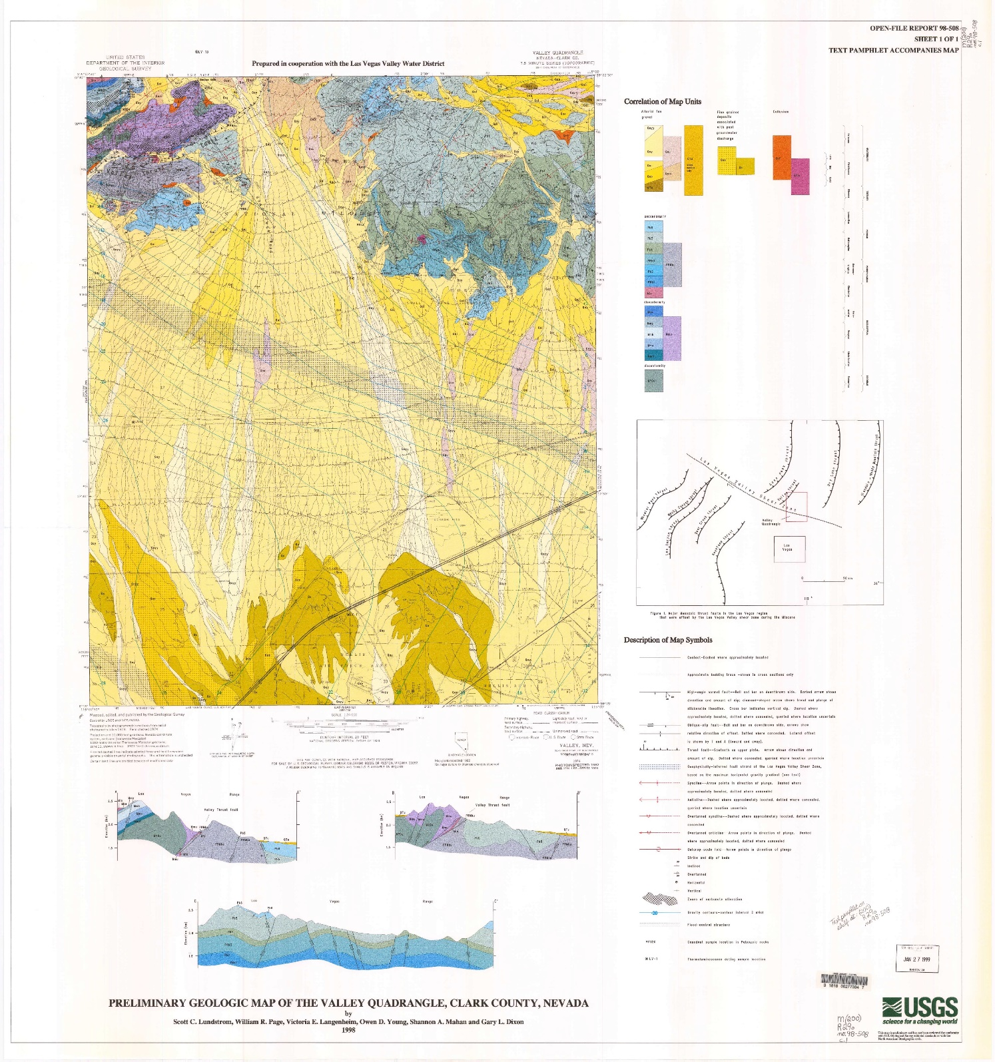
Exploration
Geological map.
Geoscientists use a combination of methods to find suitable mining locations.
Geologic maps (surface and cross sectional).
Results at other similar geological environments.
Visit potential site to complete field studies, which can include mapping, sampling, and chemical analyses.
Surface Map
Cross Sectional Map
Notes:
Image Information Slide 11 Exploration (VI):
Geologic Map: Credit: Lundstrom, S. C., Page, W. R., Langenheim, V. E., Young, O. D., and Mahan, S. A. (1998) Preliminary Geologic Map of the Valley Quadrangle, Clark County, Nevada. Downloaded from http://ngmdb.usgs.gov/Prodesc/proddesc_19423.htm under public domain courtesy of the U.S. Geological Survey (http://www.usgs.gov/laws/info_policies.html and http://www.usgs.gov/visual-id/credit_usgs.html).

Slide 24
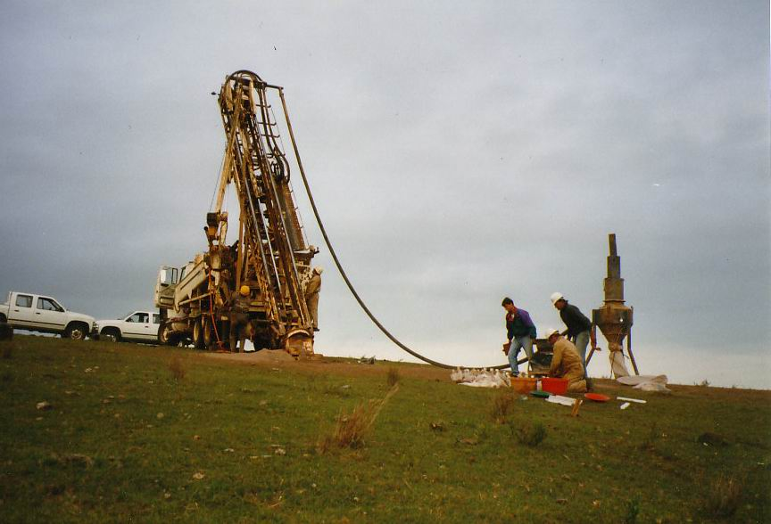
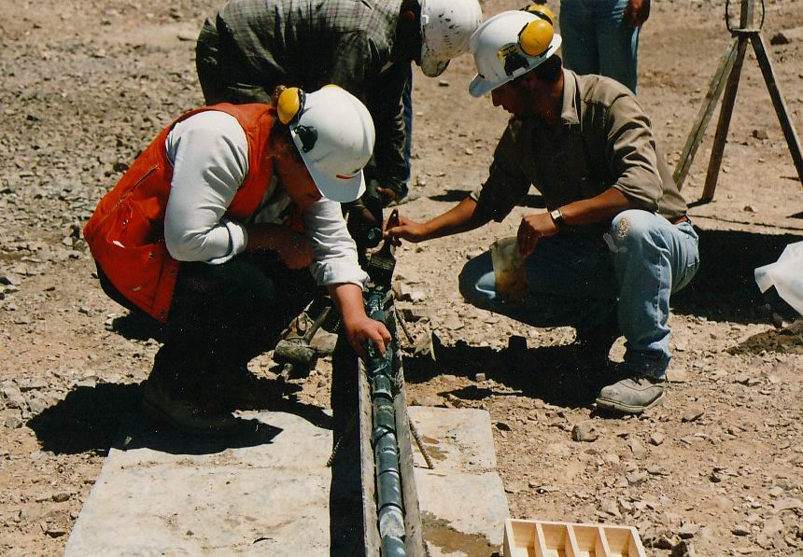
Exploration
Check out this explanation on how seismics work:
http://www.oerb.com/Default.aspx?tabid=274
Geoscientists will also:
Enact “noninvasive” depth studies.
Drill down through the surface to obtain samples.
Example of a small drill rig used for mineral exploration. Note people on right for scale.
Geoscientists examine core extracted by drill.
Notes:
If the video listed above on the OERB site is no longer accessible, you may be able to find it here: http://www.geoart.com/educational/seismic_survey.php, the site from whom the OERB is leasing it.
Image Information Slide 12 Exploration (VII):
Drill Rig: Credit: Credit: Geoz (1999) Exploration Drill (Uruguay). Downloaded from http://upload.wikimedia.org/wikipedia/commons/e/e8/Exploration_drill.jpg under a public domain license (http://commons.wikimedia.org/wiki/File:Exploration_drill.jpg#filehistory).
Extracted Core: Credit: Geoz (1994) Exploration Geologist (Chile). Downloaded from http://upload.wikimedia.org/wikipedia/commons/0/00/Exploration_geologist.jpg under a public domain license (http://en.wikipedia.org/wiki/File:Exploration_geologist.jpg).

